Slide 1


Slide 2
District President’s Report
Part 2

Slide 3

The Pacific Southwest District
The mission of the Pacific Southwest District is to effectively resource congregations and schools for transforming lives and making the Great Commission REAL!”

Slide 4
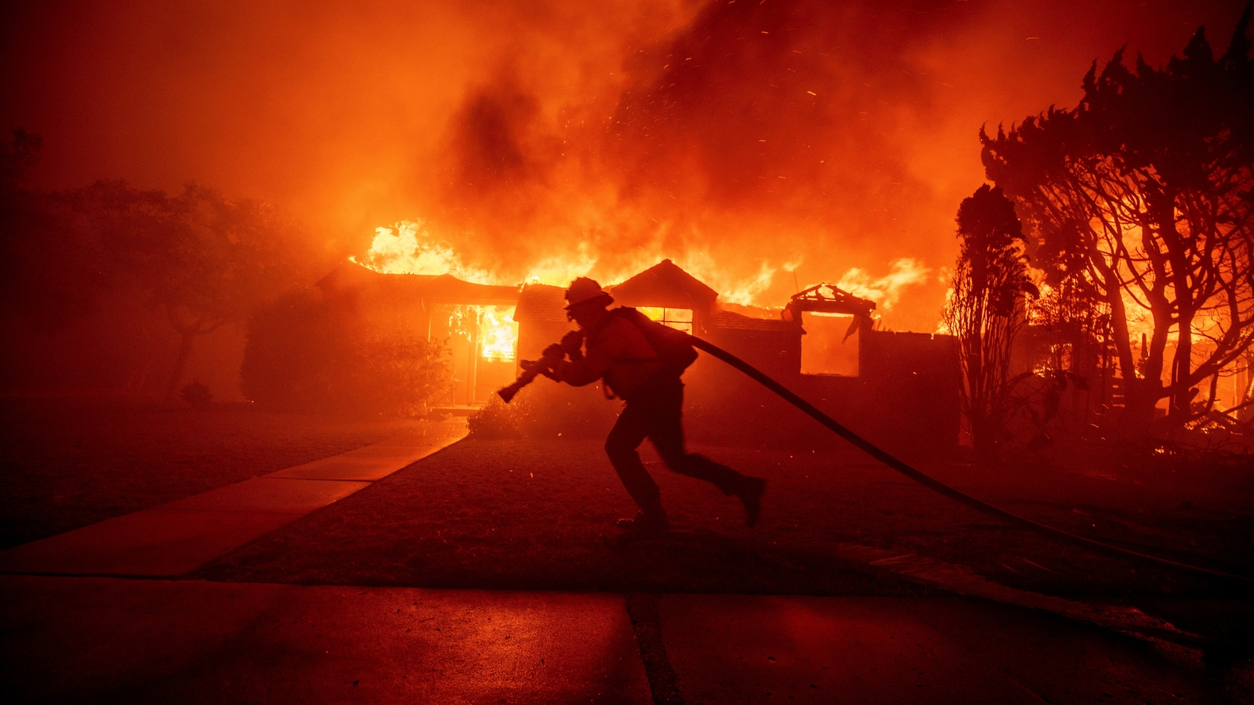
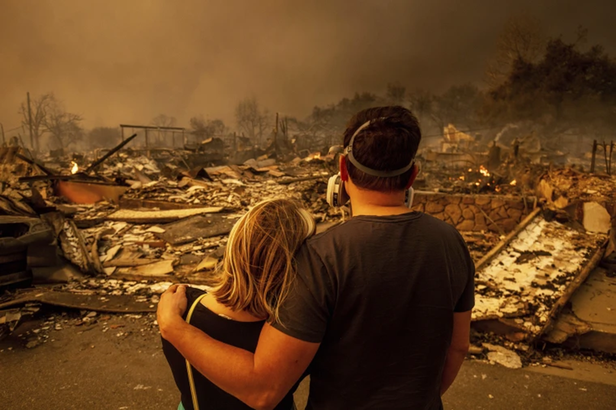
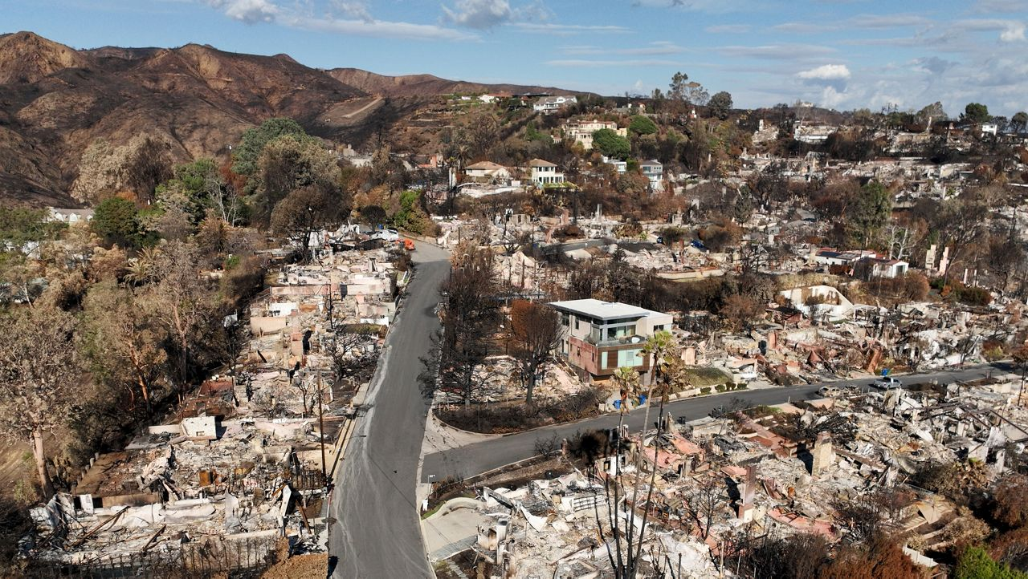
Notes:
Much of what I’m going to talk about today in my report seeks to emphasize partnerships, collaboration, resourcing in our shared ministry
Most of it pales when compared to the significant way people came together to respond to the devastating Eaton and Palisades fires that began January 7
Hurricane force Santa Ana winds
At least 30 people died, over 200,000 evacuated
More than 18,000 homes and structures destroyed
57,000 acres – 89 sq miles
Altadena, Pasadena, Palisades – significant impact in the surrounding communities.
Three PSD congregations were primarily affected: First Pasadena, Palisades Lutheran, Pilgrim, Santa Monica
Please direct your attention to the screens for this video.
VIDEO
Over 1,200 individual fire relief contributions were received
Dollars were immediate distributed for relief – a simple team reviews the requests and dollars immediately transferred into congregation accounts , quick response.
Support for many who needed housing assistance
Now in the time when our congregations are planning their long-term responses – we will resource them
Thank you to each of you, your congregations, districts across the country, LCMS Disaster Response, Lutheran Church Charities (comfort dogs)

Slide 5
The Pacific Southwest District
Please note that the prior slide has 3 photos – slow fades
Fire response video – longer cut

Slide 6
District President’s Report
Part 1 – The last 3 years (Video and Workbook)
Part 2 - Today and Tomorrow
Challenges and Opportunities
What District is doing to assist
“Redeemed to Tell” – Real examples
What’s your response?
Your Questions

Slide 7
Challenges and Opportunities

Slide 8
The Lutheran Church – Missouri Synod
Attendance and Numbers of Congregations
Year 0-50 50-99 100-199 200-499 500+ Total
2023 2,288 1,506 857 504 90 5,761
66% of Synod Congregations worship under 100
40% worship under 50
9% did not report statistics

Slide 9
Pacific Southwest District
Attendance and Numbers of Congregations
1973, 1994, 2023
Year 0-50 50-99 100-199 200-499 500+ Total
1973 12 49 66 75 10 212
1994 45 58 84 59 11 257
2023 118 73 38 28 6 263
73% of PSD Congregations worship under 100
45% worship under 50
7.7% did not report statistics

Slide 10
Pacific Southwest District
Attendance and Numbers of Congregations
1973, 1994, 2023
Year 0-50 50-99 100-199 200-499 500+ Total
1973 12 49 66 75 10 212
1994 45 58 84 59 11 257
2023 118 73 38 28 6 263
73% of PSD Congregations worship under 100
45% worship under 50
7.7% did not report statistics

Slide 11
Pacific Southwest District

Slide 12
All Protestant Churches in the US
            0 – 50 31%
            51 - 99 37%
            100 - 249 24%
            250+ 8%
Thom S. Rainer, What is a Large Church?
Churchanswers.com/blog
Redefining “Sizes”
          0 – 50 Small Churches
          51 – 99 Mid-size Churches
          100 – 249 Large Churches
          250+ Larger Churches

Slide 13
What is Our Response?
Doing nothing is not an option.
Abandoning Scripture and Confessions to be “more relevant” will never be an option.
Be careful not to make this merely about the survivability of declining churches. This is ultimately about a reduced capacity for the saving of souls.
A response is required.
  “It takes all kinds of churches to reach all kinds of people.”
  Smaller churches do incredible things.
Notes:
Unity in Christ, Scripture and Confessions is not the same thing as uniformity in practice
Yes, Confessions say that order and practices are good for us, but there is so much freedom within those basic practices
1 Corinthians 12 – honor those parts of the body that appear to be less.

Slide 14

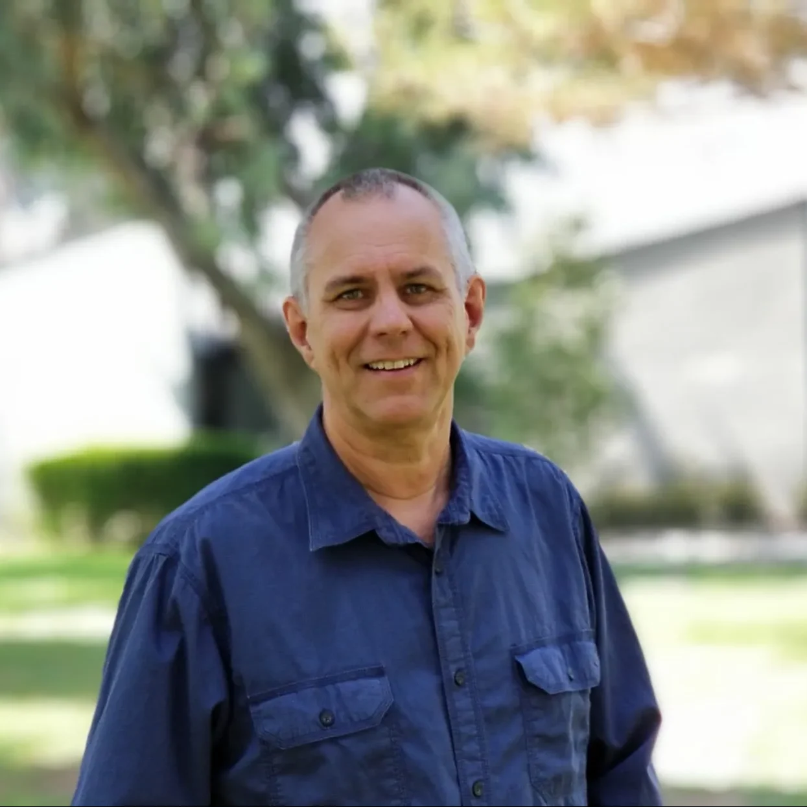
Where To Start?
PSD Small Church Conference
with Karl Vaters
4-hour video resource
Divided into 4 segments
Easy to use with your boards
https://www.psd-lcms.org/psd-videos

Slide 15
What is Our Response?
Doing nothing is not an option.
Abandoning Scripture and Confessions to be “more relevant” will never be an option.
Be careful not to make this merely about the survivability of declining churches. This is ultimately about a reduced capacity for the saving of souls.
A response is required.
  “It takes all kinds of churches to reach all kinds of people.”
  Smaller churches do incredible things.
  Churches will “partner” or they will die.
Notes:
Unity in Christ, Scripture and Confessions is not the same thing as uniformity in practice
Yes, Confessions say that order and practices are good for us, but there is so much freedom within those basic practices
1 Corinthians 12 – honor those parts of the body that appear to be less.

Slide 16
What is Our Response?
  Mid-size - Larger Churches will not isolate. They will lead the way in developing mission societies, church planting, and partnering with smaller congregations.
  A greater sense of responsibility to one another.

Slide 17

Where To Start?
Better Together – Making Church Mergers Work
Jim Tomberlin and Warren Bird

Slide 18
What is Our Response?
  Mid-size - Larger Churches will not isolate. They will lead the way in developing mission societies, church planting, and partnering with smaller congregations.
  A greater sense of responsibility to one another.
  Idolatry, self-righteousness, and grudges must be challenged.
  Assist call committees as they look for a “different type” of pastor. “One-size-fits-all” seldom works.
  Bi-vocational and Co-vocational pastors will be common.

Slide 19
What is Our Response?
BI-VOCATIONAL AND CO-VOCATIONAL PASTORS
A bi-vocational pastor's primary focus is on the church, with the marketplace job serving to supplement their income until the church can fully support them.
A co-vocational pastor has a primary calling in the marketplace and intentionally integrates their secular work with their ministry, without the expectation or desire to transition to full-time pastoral ministry.

Slide 20
What is Our Response?
  We will continue to ask seminaries to listen to congregations located “on the margins” as they describe the kind of pastors they need and the ways they want them trained.
  Intentionally form missionary-pastors.
  Offer retraining of church workers who were prepared for service in a churched culture but now find themselves enveloped in a post-church world, with or without declining congregations, and are unsure what to do.
Notes:
1. This is especially true on the coasts – because what we live out here is coming to the more churched parts of our country and synod.
2. Chaplain-Pastors
3. Al Espinosa – Faith that engages the culture
I am asking the district to include this emphasis in the sessions at the 2026 Pastors Conference and the LEC.

Slide 21
What is Our Response?
  Equip the Priesthood of Believers to do more in their communities, congregations, and alongside their pastors.
  All of this toward the outcome that Congregations and Schools will aggressively respond to the challenges and opportunities, engage our broken world for the sake of the lost, collaborate for the sake of Christ and His mission, and “tell their stories.”
Notes:
Especially true on the coasts – because what we live out here is coming to the more churched parts of our country and synod.

Slide 22
What PSD is doing to assist

Slide 23
What You Will Hear

Slide 24
What You Will Hear
  The Pacific Southwest District is focusing its efforts, leadership, training, and resources in support of congregations and schools so that YOU can effectively respond to these challenges and opportunities.
  “We must not be found guilty of burying
  God’s resources in the backyard.” (Matthew 25:14-30)
  Rev. Dr. Richard Burkey

Slide 25
What You Will Hear
What we’re doing and where we’re heading
Real examples
Cause you to rejoice
Encourage you to try
Holy Spirit to spark a next step
Return home ready for action
Collaborate with others for greater Gospel proclamation
Notes:
I want to give you a glimpse

Slide 26


Slide 27
100 in 10 – What You Will Hear
Dozens of new intentional Gospel proclaiming ministries initiated by PSD congregations.
Notes:
A small congregation - Peace in the Valley, Benson, AZ, south of Tucson. Pastor Ron York (Baptized membership of 53, Attendance of 42, Confirmed membership of 25)
Lutheran Mission Society of San Diego – over 30 lay missionaries each connected to a local LCMS congregation – influence crossing the border
Coastal – San Clemente to Ventura – new work, John Alwood
7 PSD congregations talking about charter members of the mission society.
A dozen neighborhood outposts with 25 expected by end of summer, 8 of those toward intentional church planting.
Las Vegas – LINC - A launchpad for church planters, Christian entrepreneurs, and non-profit leaders seeking to solve our cities’ deepest issues.
Partnership of First Good Shepherd, LV sharing their Pastor Brad Beckman as part-time director of LINC.

Slide 28
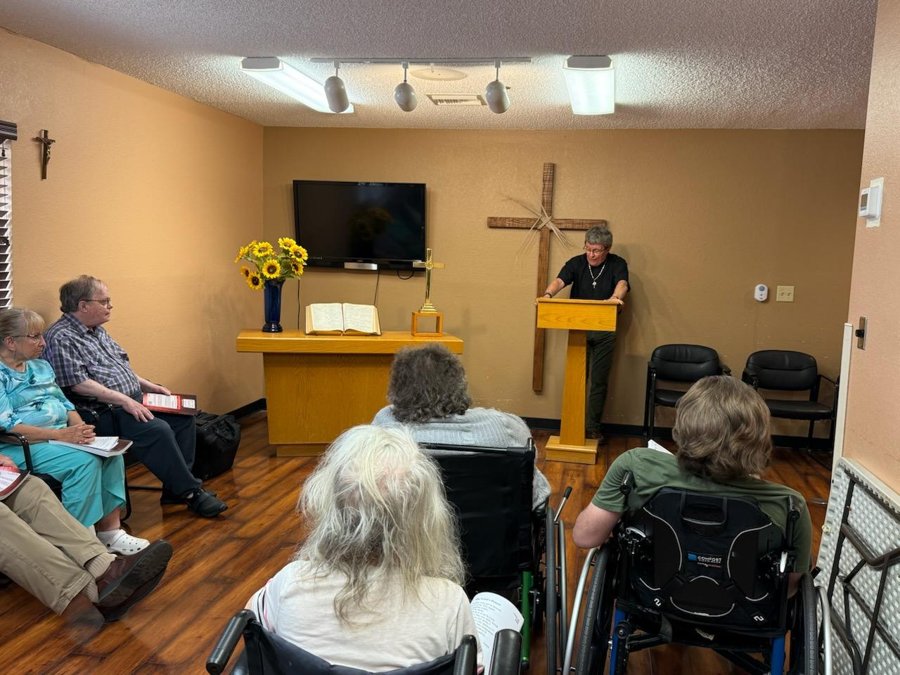
Peace in the Valley Lutheran Church
Benson, AZ
Pastor Ron York

Slide 29
100 in 10 – What You Will Hear
Dozens of new intentional Gospel proclaiming ministries initiated by PSD congregations.
Mission Societies created by congregations with a regional heart for mission and ministry.
Congregations partnering in church planting.
PSD BoD discussing the possibility of advance property purchases to accommodate Church and School ministry sites.
Notes:
A small congregation - Peace in the Valley, Benson, AZ, south of Tucson. Pastor Ron York (Baptized membership of 53, Attendance of 42, Confirmed membership of 25)
Lutheran Mission Society of San Diego – over 30 lay missionaries each connected to a local LCMS congregation – influence crossing the border
Coastal – San Clemente to Ventura – new work, John Alwood
7 PSD congregations talking about charter members of the mission society.
A dozen neighborhood outposts with 25 expected by end of summer, 8 of those toward intentional church planting.
Las Vegas – LINC - A launchpad for church planters, Christian entrepreneurs, and non-profit leaders seeking to solve our cities’ deepest issues.
Partnership of First Good Shepherd, LV sharing their Pastor Brad Beckman as part-time director of LINC.

Slide 30


Slide 31
Ministry Support – What You Will Hear
Seasons of Ministry
118 PSD congregations with less than 50 in worship.
72 “part-time” ministries – unable to afford a full-time pastor.
Time to Join
Time to Share
Time to Renew
Time to Build
Time to Grieve
None of these are accomplished alone.

Slide 32
What Happens When a Church Closes?
We grieve together and have a closing worship service of celebration.
Reversionary Clause – honor the legacy of LCMS membership.
PSD is committed to faithfully steward the gifts of God.
3-Tier Property Evaluation Model
Notes:
Jesus to Peter – “I tell you, you are Peter, and on this rock, I will build my church, and the gates of hell shall not prevail against it.”
Hell cannot prevail against the confession that Jesus is the Christ, the Son of the living God
This doesn’t apply to congregations. The Body of Christ lasts – congregations have seasons

Slide 33
What Happens When a Church Closes?
3-TIER PROPERTY EVALUATION MODEL
TIER 1: R-R-R PROPERTY
Revision and repurpose property for new launch(es)
TIER 2: HOLD AND LEASE
Generate rental revenue while determining future potential
TIER 3: SELL
Proceeds from property sale funds
mission/ministry/circuit/turn property into people

Slide 34
What Happens When a Church Closes?
We grieve together and have a wonderful closing worship service of celebration.
Reversionary Clause – honor the legacy of LCMS membership.
PSD is committed to faithfully steward the gifts of God.
3-Tier Property Evaluation Model
Real Estate Solutions (RES Solutions) – a Tier 1 Response

Slide 35
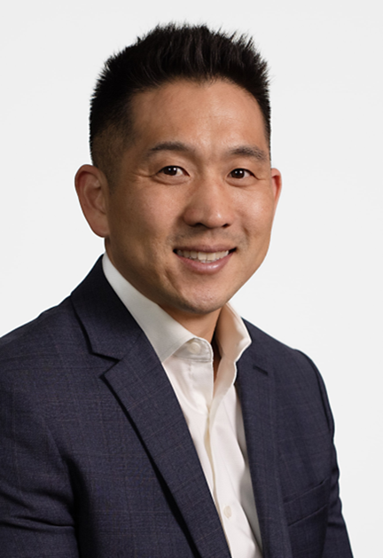
Real Estate Solutions - LCEF
How do we properly steward millions of dollars of property closures especially when we’re not in the property business?
LCEF developed Real Estate Solutions (RES). It’s a service that provides great resources, knowledge, and a partnership with LCEF that brings expertise we wouldn’t otherwise have. Available to congregations as well.
First LCMS District to have a full-time property development specialist on our staff.
Josh Rhee

Slide 36
Real Estate Solutions - LCEF
Maximize a property for the greatest future ministry potential.
Enables us to directly serve a specific community.
Creating alternative sources of revenue for ministry sustainability into the future.
If we didn’t have this option, it would force us to sell more properties and lose our footprint in communities.
Example: Gethsemane, Riverside closed at the end of 2022.

Slide 37

PSD School Ministries
Connected In Christ

Slide 38
Pacific Southwest District Schools
The schools of the Pacific Southwest District will become the private schools of choice in the Southwestern United States.

Slide 39
Schools – What You Will Hear
More than just the finest education, it’s about the salvation of souls, a legacy of faith for generations of families.
The best measurement of success for our schools is the number of baptisms that occur.
Cutting edge of innovation that never strays from Christ-centered education.

Slide 40
Pacific Southwest District Schools
Churches of every size have schools.
Our strongest, healthiest, and largest congregations have schools.
It works best when there is a Combined Church and School Ministry, where the School is the #1 Mission.
We talk about church planting, mission societies, 100 in 10, and partnerships between congregations. The same applies to schools.
Start a new school. Let our experts help!
Notes:
Join with another congregation to start an Early Childhood Center together.
Association schools are created when multiple congregations work together.
Consider unoccupied or underutilized existing PSD campuses near you and partner.
Micro-Schools, Micro-High Schools
Small Classical Education Schools

Slide 41


Slide 42
Youth and Family – What You Will Hear
“How are you going to help us get more youth and children in our church?”
“Are you willing to make the changes necessary to create an environment in your church where young families will come and stay?”
You can have a youth ministry - Collaborate
Congregations pool resources and call at DCE.
Notes:
Easy question – Difficult Answer
Maybe your focus should be on outreach to Seniors.

Slide 43
Youth and Family – What You Will Hear
PSD Collaborations
State gatherings
Congregational collaborations
National events and leadership formation
Director of Christian Education (DCE) program at Concordia University Irvine – the largest in the LCMS.
Director, Rebecca Duport and Christ College Team
Notes:
Easy question – Difficult Answer

Slide 44
Church Worker Recruitment
and
Church Worker Care

Slide 45
Recruitment and Worker Care
22.1.3 – PSD people for PSD Ministries
“I see in you . . .”
Set Apart to Serve
Who are you raising up and supporting in your congregations and schools to be a church worker, to become your Pastor, DCE, Educator?
Notes:
Easy question – Difficult Answer
Maybe your focus should be on outreach to Seniors.

Slide 47
Recruitment and Worker Care
Seen and heard advocacy – don’t forget spouses
Salary and benefits
Sabbaticals – Lutheran Church Extension Fund
Counseling and Therapy
Shepherd’s Canyon Retreat Center
Notes:
Easy question – Difficult Answer
Maybe your focus should be on outreach to Seniors.

Slide 48
District President’s Report
What happens after the Convention?
Relieved and Ready to go home?
With a notebook full of ideas
What Season are we in and what to do about it?
Collaborations, partnerships to pursue
What’s our first step?
The Redeemed of the Lord tell their stories!
Notes:
A new pastor – 1 year out of seminary told me recently – I’m going to work with the other pastors in our area to ensure that every congregation is support, served, and has some level of pastoral care.

Slide 49
At This Convention . . .
2022 Convention Resolutions - Marching Orders
RESOLUTION 22.3.2 To reject racism, rectify past wrongs of commission and omission, and recognize the Pacific Southwest District successes, failures, and opportunities in ministry within communities. . . be distributed to all congregations in the District, made available on the District website, and discussed at the 2025 Pacific Southwest District Convention.
Thursday, 4:45-5:30 PM

Slide 50
District Staff
Pacific Southwest District Team
Convention Workbook, page 37
Departing Staff
Rachel Klitzing (34 years)
Rev. Dominic Rivkin (6 years)
Dr. Victoria Waffle (12 years)

Slide 51
Your Questions

