Slide 1
WORD -> MISSION -> CHURCH

Slide 5
Missio Dei God’s Mission “to love”

Slide 6
The earth is the Lord’s and all that is in it,
the world, and those who live in it,
for he has founded it on the seas
and established it on the rivers.
Psalm 24:1-2

Slide 7
God’s love was revealed among us in this way:
God sent his only Son into the world so that we might live through him. In this is love, not that we loved God but that he loved us and sent his Son to be the atoning sacrifice for our sins. Beloved, since God loved us so much, we also ought to love one another.
1 John 4:9-11

Slide 8
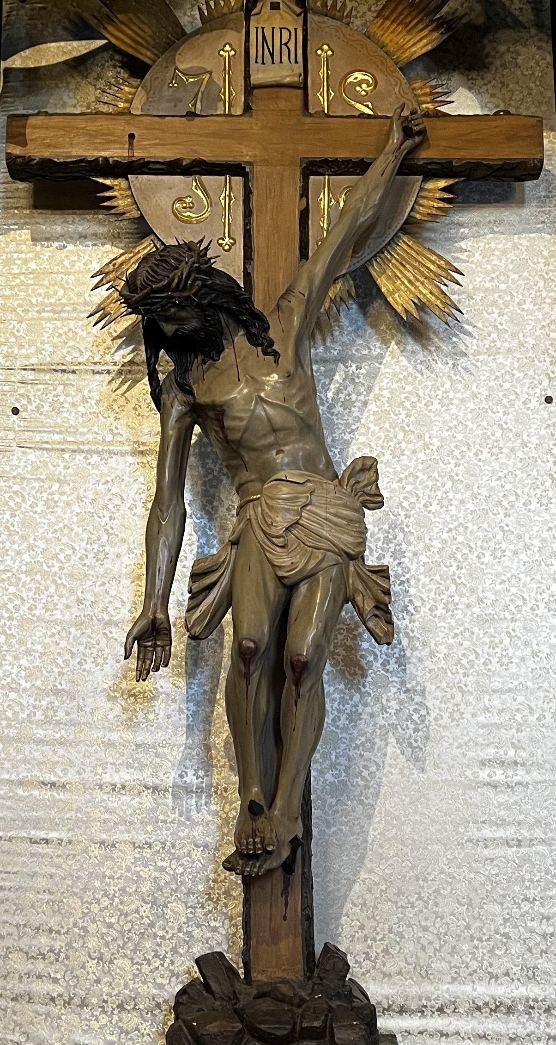
You did not choose me, but I chose you. And I appointed you to go and bear fruit, fruit that will last, so that the Father will give you whatever you ask him in my name. John 15:16

Slide 9
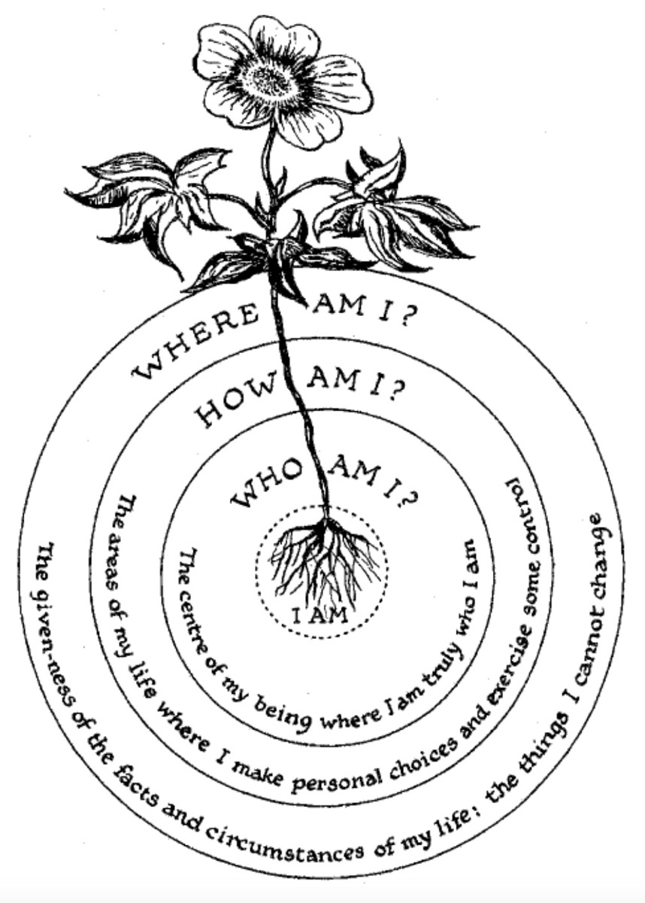
Inner Compass, Margaret Silf

Slide 10
When we claim and constantly reclaim the truth of being the chosen ones, we soon discover within ourselves a deep desire to reveal to others their own chosenness. Instead of making us feel that we are better, more precious or valuable than others, our awareness of being chosen opens our eyes to the chosenness of others. That is the great joy of being chosen: the discovery that others are chosen as well.
― Henri J.M. Nouwen,
Life of the Beloved: Spiritual Living in a Secular World

Slide 12
CHURCH AND COMMUNITY ReNEW
OUTREACH
CHURCH
INREACH
OUTREACH
INREACH
LEADERSHIP
GROWING
TOGETHER
PASTOR
COMMUNITY
PASTOR
LEADERSHIP
CONGREGATION
COMMUNITY
CONGREGATION

Slide 13
The VISION
FAITH COMMUNITIES THAT VALUE...
The Mission of God
Forgiving and reconciling
The Mandate of the Church
Responding to the call and proclaiming the Gospel to all people
The Method of Ministries
The Measure of Success
Establishing new LCMS faith
every human soul in Christ Jesus
communities and reaching people with the Gospel
Serving, connecting, and
cooperating with the wider community in mission
Faith Communities engaging in intentional Gospel proclamation, saturating regions and transforming lives in the Pacific Southwest District

Slide 14
The MISSION
Our STRATEGY
Pray and Study:
Seek the Mission of God in Christ
and the Movement of the Spirit
Engage and Gather:
Connect Local Ministries and Leaders to Build Teams and Coordinate Efforts
Train and Coach:
Equip and Encourage to Launch New
Ministries that Reach New People
Celebrate and Communicate:
Inspire Others in the PSD to Support and Participate in 100 in 10
To facilitate the launch of 100 new faith communities by the 100th anniversary of the Pacific Southwest District of the LCMS in 2031.
RESOLUTION 22.1.1

Slide 15
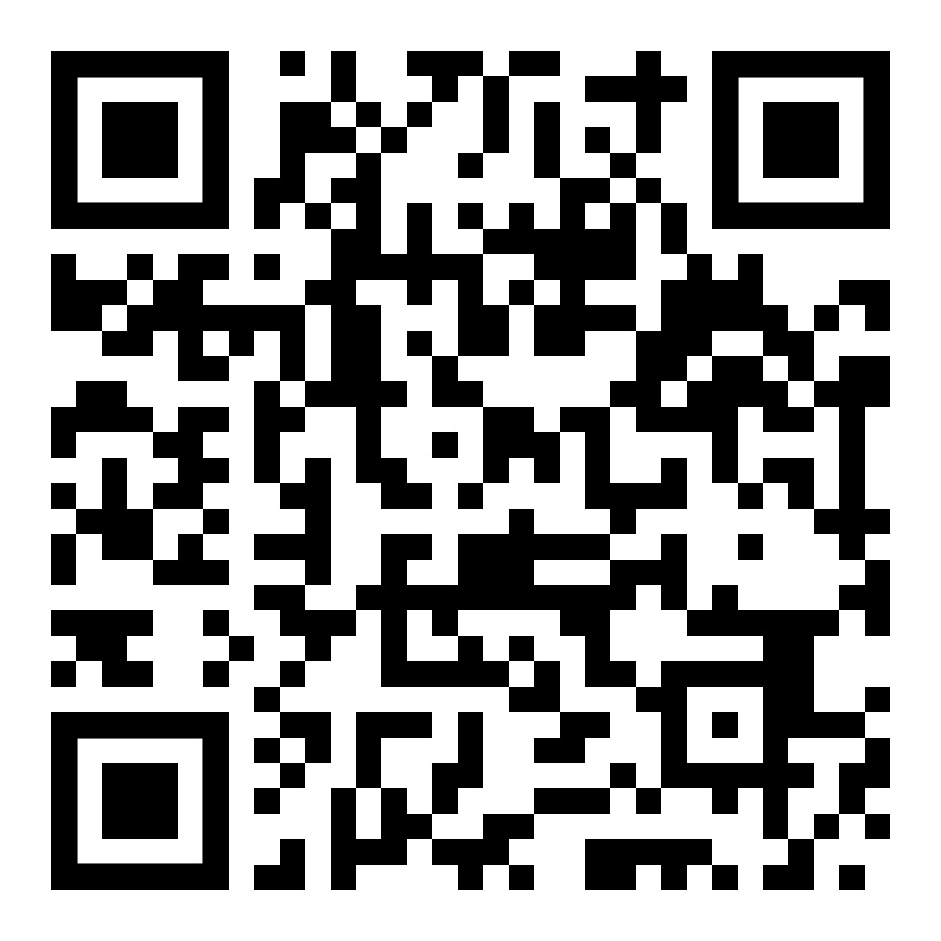
PRAY FOR MISSION
24/7 Virtual Prayer Room
Advent - Epiphany
December 3,2023 – January 6, 2024

Slide 16
Study Mission Basics

Slide 17
Engage and Gather
Congregational Mission Advising
Circuit Mission Equipping
Regional Mission Societies

Slide 18
Train and Coach
GSE Cohorts
PSD Coaching Network

Slide 19
Celebrate and Communicate
New Faith Community Stories
https://www.psd-missions.org/100-in-10

Slide 20
Eight Submissions Since JUNE!
Micro-High School
Pre-School Program Expansion
Retirement Home Ministries
Celebrate Recovery Groups
Neighborhood Micro-Churches
Seeds for New Church Plants

Slide 21
Celebrate and Communicate
Grant Submission, Approval, and Support Improvements
E-Resources

