Slide 1


Slide 2
Seasons of Ministry
Rev. Jim Henkell, PSD Ministry Executive

Slide 3

Three Questions
Why aren’t people attending like they used to?
Why don’t our outreach events result in new members?
Why is it so difficult to attract younger people?

Slide 4
Questions Reveal as Much as Answers
Viability vs. Opportunity
Congregation vs. Kingdom

Slide 5


Asking a Different Question
John 9

Slide 6
What is God Doing?
Redeeming All Things (Romans 8)
Guiding Us Forward (Philippians 3)
Bringing Us Together (1 Corinthians 12)

Slide 7
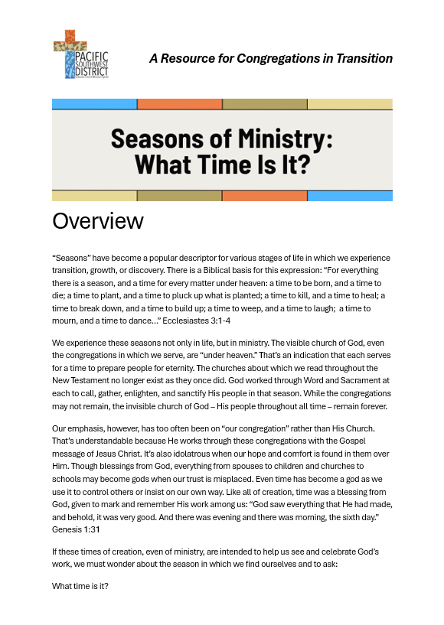
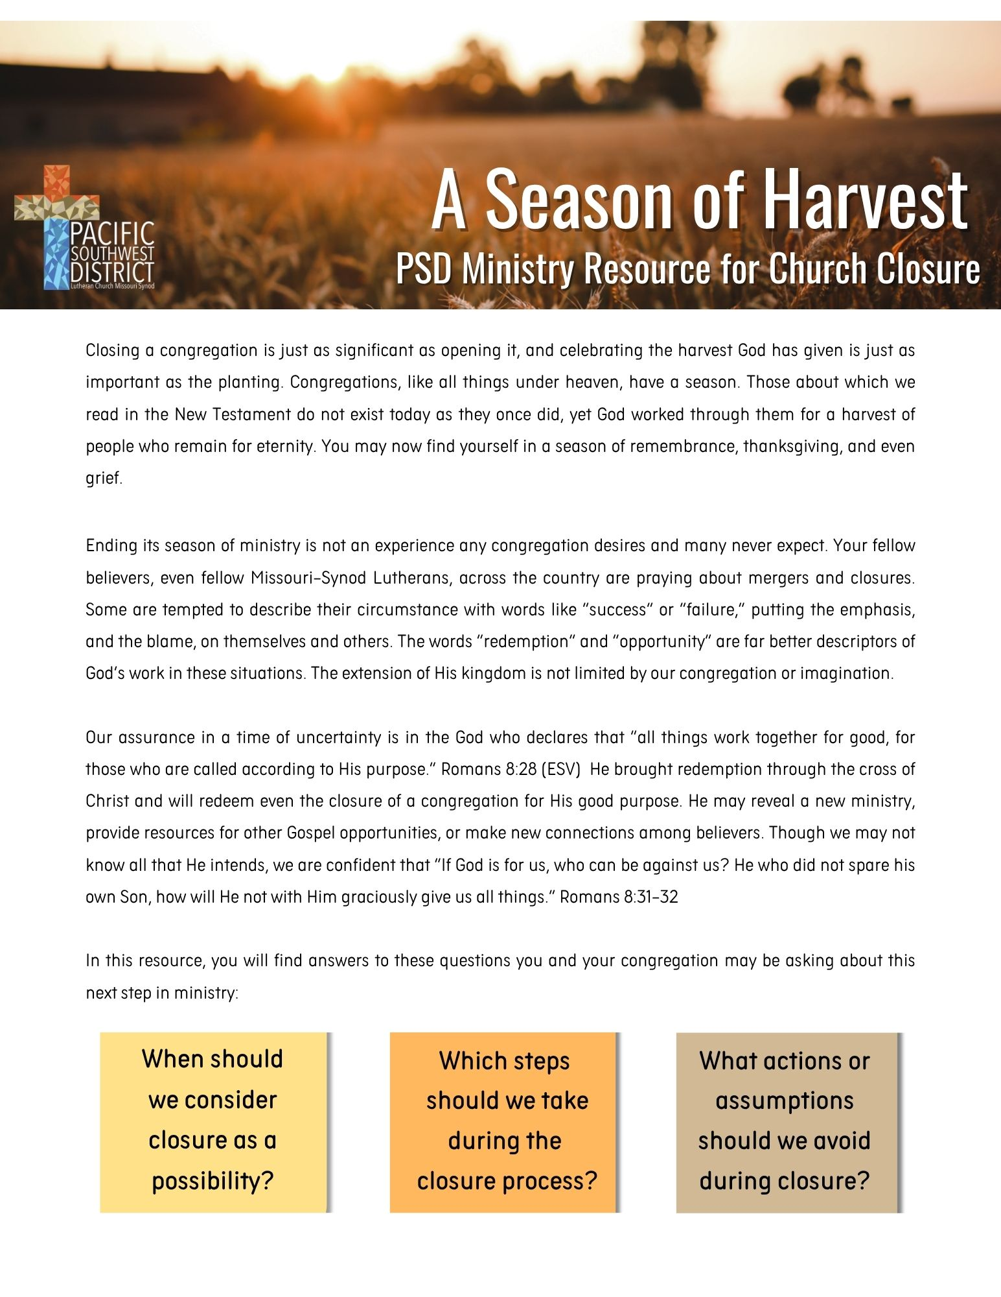
What Season Are You In?

Slide 8
“Let the redeemed of the Lord tell their story.”
“Let the redeemed of the Lord tell their story.”
– Psalm 107:2
– Psalm 107:2
Questions? Email jim.henkell@psd-lcms.org

