Slide 1
Christocentric What Does This Mean?

Slide 2
“All of theology has been embraced in Christology. Without Christ one cannot speak properly about God or about creation, not to mention redemption and eternal glory. Everything is comprehended in him, and everything refers to him.” (Confessing the Gospel: A Lutheran Approach to Systematic Theology, 416)

Slide 3
To be faithful to “the whole counsel of God” (Acts 20:27) centers on Jesus Christ. What does “Christocentric” mean in preaching, teaching, and in the care of souls, our own and those committed to our ministry?
How 1 Peter Presents Christ…
Today: One Christ, and He Is Now!
Tomorrow: Caring for Souls: This Worldliness
Wednesday: The Goal of Soul Care: the Mystic Close
To begin, let us pull back…

Slide 4
“In the beginning God…”
© NASA

Slide 5
© NASA
…created
the
heavens

Slide 6
Sagitarius A* May 12, 2022
“I am in awe because that’s our supermassive black hole,” said University of Connecticut physicist Dr. Chiara Mingarelli… ‘It feels very personal to see it for the first time, to have that undeniable image of it’”
“The surest way to suppress our ability to understand the meaning of God and the importance of worship is to take things for granted. Indifference to the sublime wonder of living is the root of sin.” Abraham Heschel

Slide 7
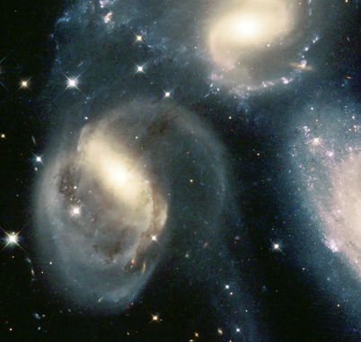
“I will question you, and you make it known to me.”
“Where is the way to the dwelling of light, and where is the place of darkness, that you may take it to its territory and that you may discern the paths to its home?”
Job 38

Slide 8
© NASA
“…and the Earth”

Slide 10
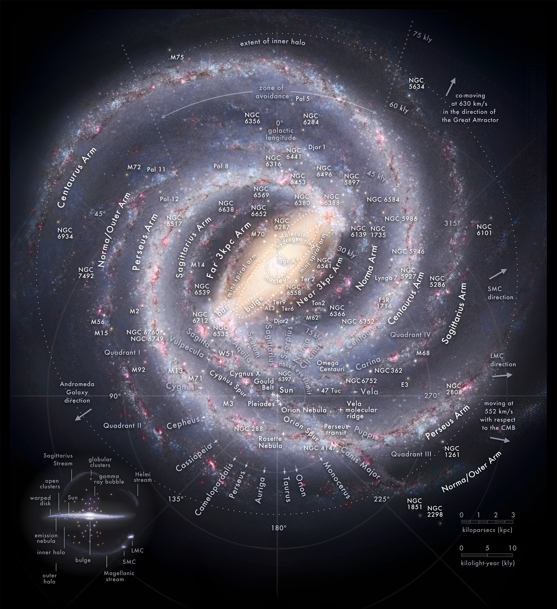

Slide 11
Awe, the Fear of God
“When I look at your heavens, the work of your fingers, the moon and the stars, which you have set in place, what is man that you are mindful of him, and the son of man that you care for him?”
Psalm 8:3-4

Slide 12
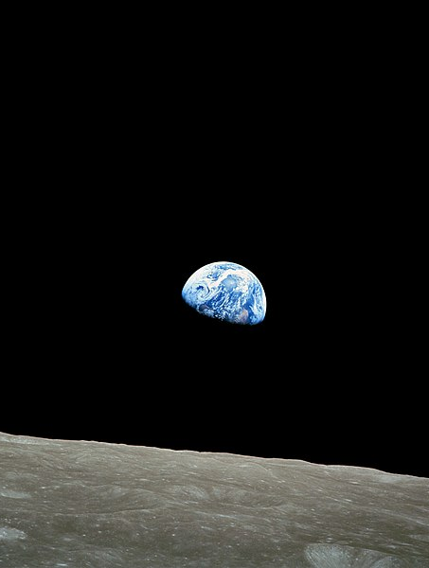
“God, who said, ‘Let light shine out of darkness,’ has shown in our hearts to give the light of the knowledge of God in the face of Jesus Christ” (2 Corinthians 4:6).

Slide 13
Christocentricity = One Christ
“It is the right faith that we believe and confess that our Lord Jesus Christ, the Son of God, is at the same time both God and man… Although He is God and man, He is not two, but one Christ: one, however, not by the conversion of the divinity into flesh, but by the assumption of the humanity into God; one altogether, not by confusion of substance, but by unity of person. For as the rational soul and flesh is one man, so God and man is one Christ.” (Athanasian Creed, 28, 32-35)

Slide 14
How do your hearers picture the one Christ?
“If an ox could paint a picture, his god would look like an ox.” (Xenophanes, a Greek philosopher of the late 6th and early 5th century B.C.)
“On the one hand, divine images are indeed shaped by human imagination, by the imagination of a society longing for the visualization of the invisible in word and image and by the imagination of the artist or the author reacting to the call of his social surrounding. But on the other hand…

Slide 15
How do your hearers picture the one Christ?
“But on the other hand, these divine images – conceived, invented, visually and verbally produced in various historical and ritual situatiions – in turn become models that would ‘mould’ human imagination.” (Joannis Mylonopoulos in Divine Images and Human Imaginations in Ancient Greece and Rome, 18)

Slide 16
How do your hearers picture the one Christ?
“You have not seen him, you love him. Though you do not now see him, you believe in him and rejoice with joy that is inexpressible and filled with glory, obtaining the outcome of your faith, the salvation of your souls.” (1 Peter 1:8-9)
How would 1 Peter have us picture Christ?

Slide 18
© CPH. Used with permission

Slide 19
© CPH. Used with permission

Slide 20
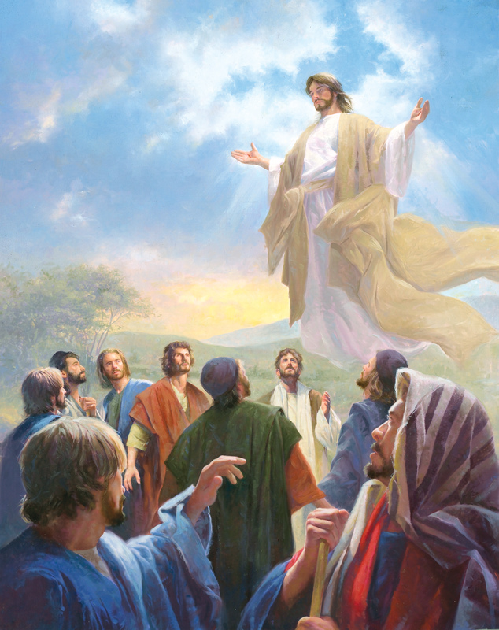
“He ASCENDED into heaven and SITS at the right hand of God the Father almighty”(Apostles’ Creed)
“All authority in heaven and on earth has been given to me” (Matthew 28:18)
“All things have been handed over to me by my Father” (Matthew 11:27)
© CPH. Used with permission

Slide 21
Where is Christ NOW?
Christ ‘descended into hell, truly rose from the dead on the third day, ascended into heaven, is sitting at the right hand of God’ in order to rule and reign forever over all creatures, so that through the Holy Spirit he may make holy, purify, strengthen, and comfort all who believe in him, also distribute to them life and various gifts and benefits, and shield and protect them against the devil and sin” (AC III, 4-5, G).

Slide 22
State of Humiliation is Past
“As man, Christ did not always or fully use or manifest the divine powers and majesty that were communicated to His human nature. This began with the lowly manner of His incarnation, continued in the manner of His birth and life, and was completed with His death and burial. We call this His state of humiliation.” (Luther’s Small Catechism with Explanation, 183)

Slide 23
NOW: State of Exaltation
“Jesus, who remains true man, manifests the divine attributes communicated to Him in His incarnation. His power and majesty are manifest fully and constantly in His victorious descent into hell, His resurrection from the dead, His ascension into heaven, His present reign at the right hand of God, and His future return for judgment. We call this His state of exaltation.” (Luther’s Small Catechism with Explanation, 183)

Slide 24
Again, when your hearers leave church, what image do they have of Christ? Do hearers know where they are located on the timeline of salvation? Do they have an image of Him as He is NOW?

Slide 25
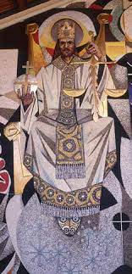
“He is the image of the invisible God, the firstborn of all creation. For by him all things were created, in heaven and on earth, visible and invisible, whether thrones or dominions or rulers or authorities—all things were created through him and for him. And he is before all things, and in him all things hold together. And he is the head of the body, the church. He is the beginning, the firstborn from the dead, that in everything he might be preeminent. For in him all the fullness of God was pleased to dwell, and through him to reconcile to himself all things, whether on earth or in heaven, making peace by the blood of his cross.” (Colossians 1:15-20)

Slide 26
“In these last days he has spoken to us by his Son, whom he appointed the heir of all things, through whom also he created the world. He is the radiance of the glory of God and the exact imprint of his nature, and he upholds the universe by the word of his power. After making purification for sins, he sat down at the right hand of the Majesty on high, having become as much superior to the angels as the name he has inherited is more excellent than theirs.” (Hebrews 1:2-4)

Slide 27
“The immeasurable greatness of his power toward us who believe, according to thew working of his great might that he worked in Christ when he raised him from the dead and seated him at his right hand in the heavenly places, far above all rule and authority and power and dominion, and above every name that is named, not only in this age but also in the one to come. And he put all things under his feet and gave him as head over all things to the church, which is his body, the fullness of him who fills all in all.” (Ephesians 1:19-23).

Slide 28
“He was foreknown before the foundation of the world but was made manifest in the last times for your sake, who through him are believers in God, who raised him from the dead and gave him glory….”(1 Peter 1:20-21)
“Jesus Christ…has gone into heaven and is at the right hand of God, with angels, authorities, and powers having been subjected to him.” (1 Peter 3:21-22)

Slide 29
3 versus 10
In 1 Peter…
Only three passages mention the resurrection (1 Peter 1:3, 21; 3:21; note 4:6)
Ten passages explicitly mention or implicitly assume Christ’s session and return in judgment and glory. Not Yet.
What is the “living hope”? ( 1 Peter 1:3, 13, 21; 3:15)

Slide 30
What Christ at the Right Hand of God Is Doing for Us Now
Stirs our imagination (faith):
All things, visible and invisible, are (now) subjected to Him – 1 Peter 3:22; Ephesians 1:19-23
Turns us to the future (hope):
“From thence He will come to judge the living and the dead” (Apostles’ Creed)
Creates unique community (love):
Loving God and one another : 1 Peter 1:8, 22-25; 4:7-11
Longing for His future: Word (1 Peter 1:23-25; 2:3); Dynamic Sacraments (Romans 6:4-5; 1 Peter 3:21)

Slide 31
Now – Not Yet (cont’d)
Promises
our faith and hope will be vindicated – 1 Peter 2:7-8; 4:4-6
Honor
Prays
Hears our prayers – Hebrews 4:5 (1 Peter 3:7; 4:7)
Intercedes for us – Hebrews 7:25; Romans 8:34
Graces us
Toward the telos – 1 Peter 1:9. Contrast John 17:3
In every need – 1 Peter 5:10
Proleptic grace – 1 Peter 1:13
Makes His face to shine upon us

Slide 32
What happens when we don’t stress Christ as He is NOW, reigning and soon to come in final judgment?
“In short, the modern world quite literally “manages” without God. We can do so much so well by ourselves that there is no need for God, even in his church. Thus we modern people can be profoundly secular in the midst of explicitly religious activities. Which explains why so many modern Christian believers are atheists unawares….

Slide 33
“Professing to believe in supernatural realities, they are virtual atheists; whatever they say they believe, they show in practice that they function without practical recourse to the supernatural…. The call to follow Jesus Christ runs directly counter to this deadly modern pressure toward secularization.” (Os Guinness, The Call, 149)

Slide 34
Taking atheism personally…
“A third shadow common among leaders is ‘functional atheism,’ the belief that ultimate responsibility for everything rests with us. This is the unconscious, unexamined conviction that if anything decent is going to happen here, we are the ones who must make it happen – a conviction held even by people who talk a good game about God.” – Parker J. Palmer, Let Your Life Speak: Listening for the Voice of Vocation, 88

Slide 35
What happens when we don’t stress Christ as He is NOW?
“Belief that Jesus of Nazareth has been raised from the dead is closely linked in the New Testament with the belief that he has been taken into heaven, where, in the words of the psalm (110:1), he has been seated at the right hand of God…. We are safe in saying it is impossible to collapse the ascension into the resurrection or vice versa. You can’t get away with the suggesting that “Jesus is raised from the dead” and “Jesus is ascended into heaven” are two ways of saying the same thing….
In fact, some kind of belief in Jesus’s ascension has recently been shown to be not just a strange added extra to Christian belief, as has sometimes been thought, but a central and vital feature without which all sorts of other things start to go demonstrably wrong.” (N.T. Wright, Surprised by Hope, 109)

Slide 36
“What happens when you downplay or ignore the ascension? The answer is that the church expands to fill the vacuum. If Jesus is more or less identical with the church—if, that is, talk about Jesus can be reduced to talk about his presence within his people rather than his standing over against them and addressing them from elsewhere as their Lord, then we have created a high road to the worst kind of triumphalism… The church effectively presented itself (with its structures and hierarchy, its customs and quirks) instead of presenting Jesus as its Lord and itself as the world’s servant. And the other side of triumphalism is of course despair. If you put all your eggs into the church-equals-Jesus basket, what are you left with when, as Paul says in the same passage, we ourselves are found to be cracked earthenware vessels.” (112)

Slide 37
Framing Advent Sermon Texts
Series A - Matthean themes:
The Reign of Heaven (Kingdom of God/Heaven)
“The end has already happened, in and through and to and for Jesus of Nazareth. The Judgment Day has taken place, on Good Friday; the apocalyptic signs that accompanied the death of Jesus make that abundantly clear. Jesus received the Father’s end-time judgment against sin, and he did so as the ransom payment in the place of the many….

Slide 38
“The Judgment Day occurred on Easter, proleptically, as death was permanently overthrown in the case of Jesus… The end has happened in Jesus…. And yet, the end is not yet. For only Jesus has risen bodily, and the world is still full of sin and brokenness….The reign of God is God’s action in Jesus to restore the world, overcoming Satan and sin completely… Thus, the reign of God is already, and it is not yet. Faith looks to the already; hope longs for the not yet.” (Gibbs, 51)

Slide 39
Advent 1 – November 27
Mathew 24:36-44 (End Times) or Matthew 21:1-11 (Palm Sunday)
“Hosanna to the Son of David! Blessed is he who comes in the name of the Lord! Hosanna in the highest!”
Preaching on both texts enables you to preach Now/Already and Not Yet

Slide 40
Advent 2 – December Matthew 3:1-12 (John the Baptist)
¹⁰Even now the axe is laid to the root of the trees. Every tree therefore that does not bear good fruit is cut down and thrown into the fire.
¹¹“I baptize you with water for repentance, but he who is coming after me is mightier than I, whose sandals I am not worthy to carry. He will baptize you with the Holy Spirit and with fire. ¹²His winnowing fork is in his hand, and he will clear his threshing floor and gather his wheat into the barn, but the chaff he will burn with unquenchable fire.” Cf. 1 Peter 4:17

Slide 41
Reading and Preaching the OT
“Matthew, like the other NT authors, insists that the OT should be read with an eye toward its fulfillment in Jesus. This means that the two Testaments have an essential unity and that the disciples of Jesus should never read the OT without asking the question ‘How does this passage ultimately point me to Jesus of Nazareth?’” (Gibbs, 54)

Slide 42
Advent 3 – December 11 Isaiah 35:1-11
¹The wilderness and the dry land shall be glad; the desert shall rejoice and blossom like the crocus… ²They shall see the glory of the Lord, the majesty of our God. ³Strengthen the weak hands, and make firm the feeble knees. ⁴Say to those who have an anxious heart, “Be strong; fear not! Behold, your God will come with vengeance, with the recompense of God. He will come and save you.” ⁵Then the eyes of the blind shall be opened, and the ears of the deaf unstopped…

Slide 43
An Advent Sermon on Joshua 1:1–6; 1 Peter 1:3–9; Hebrews 4:1–1
1. Is there anything more important to you than entering heaven, the eternal promised land?
2. All the advents of Jesus are leading to his final, decisive advent on the last day.
3. Not every ancient Israelite entered the ancient promised land; not everyone today will enter heaven.
4. God’s ancient congregation forgot the jealous God who had brought them out of slavery.
5. This deserves our greatest care. There is no more important stewardship than the stewardship of your eternal salvation.
6. Are you trusting the promises? Does your faith see? “The goodly land I see…” (The God of Abr’ham Praise)
7. So as the holidays wear down, and wear you down, I pray your anticipation of the glorious future will grow exponentially, as the Spirit of God and Jesus does through his Word and promises.

Slide 44
Christocentricity
“Following Luther, the theologians of Lutheran orthodoxy make Christ the central theme of all Scripture. ... This conviction of all the orthodox Lutherans that the Christocentricity of Scripture as a hermeneutic principle dovetails perfectly with their belief that the theology of Scripture is one unified Christian theology, with their strong and consistent christological exegesis of the Old Testament, with their emphasis on the analogy of faith as a hermeneutical norm, and with their understanding that all Scripture is Law or Gospel….

Slide 45
“To be sure, there is a vast difference between the Old and New Testament Scriptures in their presentation of doctrine; there is a definite unfolding and advance in clarity as well as phraseology and thought. The Old Testament Scriptures present the doctrine under different circumstances and different times; in the Old Testament Christ is prefigured under shadows and types as something to come. But substantially the theology of Scripture is one, even as Christ is one. Tempora variata sunt, non fides. (Robert Preus, Theology of Post-Reformation Lutheranism, II, 331-332)

Slide 46
What Image of Jesus Do Worshippers Take Home?
“It is in fact a prayer that we might ever be found in the light of the face of Christ…. Living the Christian life is living always in the light of Christ’s countenance. We are not alone—always His face is upon us. Not that we can always discern Him. Clouds of doubt, shadows of sin, obstacles of grief, or illness, may come between Him and ourselves. But He is ever there to forgive, to comfort, to encourage. We turn toward Him and find joy; as the flowers of the field turn toward the sun and find strength. As the light of the sun is the source of all earthly life so the light in the face of Jesus Christ is the source of our earthly joy and eternal hope. ‘He reflects the glory of God—upholding the universe by His word of power’ (Hebrews 1:3). Conrad Bergendoff, in For All the Saints, IV, 158

Slide 48
Christocentric What Does This Mean?

Slide 49
Yesterday: One Christ, and He Is Now!
Today: Christocentric means
Caring for Souls: This Worldliness
Tomorrow: The Goal of Soul Care: The Not Yet
First, let’s pull back again…

Slide 55
“This Worldliness”
“During the last year or so I’ve come to know and understand more and more the profound this-worldliness of Christianity. The Christian is not a homo religious, but simply a man, as Jesus was a man – in contrast, shall we say, to John the Baptist. I don’t mean the shallow and banal this-worldliness of the enlightened, the busy, the comfortable, or the lascivious, but the profound this-worldliness, characterized by discipline and the constant knowledge of death and resurrection. I think Luther lived a this-worldly life in this sense.
“I remember a conversation that I had in America thirteen years ago with a young French pastor. We were asking ourselves quite simply what we wanted to do with our lives. He said he would like to become a saint (and I think it’s quite likely that he did become one). At the time, I was very impressed, but I disagreed with him, and said, in effect, that I should like to learn to have faith….

Slide 56
I discovered later, and I’m still discovering right up to this moment, that it is only by living completely in this world that one learns to have faith. One must completely abandon any attempt to make something of oneself, whether it be a saint, or a converted sinner, or a churchman (a so-called priestly type!), a righteous man or an unrighteous one, a sick man or a healthy one. By this-worldliness I mean living unreservedly in life’s duties, problem, successes and failures, experiences and perplexities. In so doing we throw ourselves completely into the arms of God, taking seriously, not our own sufferings, but those of God in the world – watching with Christ in Gethsemane. That, I think, is faith; that is metanoia; and that is how one comes a man and a Christian.
“May God in His mercy lead us through these times; but above all, may He lead us to Himself.” (Letters and Papers from Prison, Collier; pp. 369-370)

Slide 57
Bonhoeffer was a theological intellectual who sought faith by plunging himself into “this worldliness”.
What about people and parishioners who are hurting in their lives, in their own Gethsemanes, but have only shallow biblical knowledge?
How do we provide soul care for them?

Slide 64
Mediating Institutions
Families
Local Governments
Community Organizations
Veterans’ Organizations
Unions
Lodges
Clubs
and
Your Congregation

Slide 65
What is a “mediating institution”?
“One of the most vital insights of modern social thought is the importance of mediating institutions–churches, schools, fraternal organizations, professional associations, and even clubs–for a free society. Not only are they effective, sometimes crucial, in providing services of all sorts, they are, as Tocqueville pointed out, a bulwark of freedom against the encroaching power of the state. The recognition of the consequence of these associations is especially significant for Americans because we have been particularly adept at forming them.” (Mediating Institutions, William Klimon, Acton Institute)

Slide 66
1 Peter demonstrates the mediating function of faith: How should a believer interact with an impersonal, sometimes cruel society?
General rubric:
1 Peter 2:11-12 – “Beloved, I urge you as sojourners and exiles to abstain from the passions of the flesh, which wage war against your soul. Keep your conduct among the Gentiles honorable, so that when they speak against you as evildoers, they may see your good deeds and glory God on the day of visitation.”
Specific vocational instruction:
2:13-17 – In subordination to government
2:18-25 – In subordination to masters
3:1-6 – In subordination to unbelieving husbands
3:7 – Believing husbands toward wives
3:8-12 – In general

Slide 67
Threads through 2:11-3:12
Subordination (hyptasso) because of Christ (dia ton kyrion)
Good works
As is the will of God (v. emotion-driven conduct)
As witness to non-Christian society
But if you still suffer, look to Christ who
suffered unjustly
but is now exalted, just as you will be vindicated and honored when He appears in glory.
“And who will harm you, if you are eager to do good? But even if you might suffer because of righteousness (Christ), you are blessed” (3:13)

Slide 68
It is almost impossible for us to put ourselves in their shoes. E.g., Government, 2:13-17
No separation of Church and State (First Amendment)
No automatic citizenship (14th Amendment): Historically citizenship by birth was only to people born in the city of Rome. By the first century B.C. it was extended to all in Italy. It was often given to soldiers upon retirement. A slave could purchase his freedom or have it given to him by his master. In such a case, the slave, now a freedman, was still obligated to his former master. In 212 A.D. the Emperor Caracalla extended citizenship to all within the Empire. (Constitutio Antoniniana)

Slide 69
No Due Process (14th Amendment)
“This is the course that I have adopted in the case of those brought before me as Christians. I ask them if they are Christians. If they admit it, I repeat the question a second and a third time, threatening capital punishment; if they persist, I sentence them to death. For I do not doubt that, whatever kind of crime it may be to which they have confessed, their pertinacity and inflexible obstinacy should certainly be punished. There were others who displayed a like madness and whom I reserved to be sent to Rome, since they were Roman citizens. Thereupon the usual result follow; the very fact of my dealing with the question led to a wider spread of the charge, and a great variety of cases were brought before me. An anonymous pamphlet was issued, containing many names. All who denied that they were or had been Christians I considered should be discharged, because they called upon the gods at my dictation and did reverence, with incense and wine, to your image…” (Pliny to Trajan, 112 A.D.)

Slide 70
Bridging from then to now…
Peter is not-negative about the Roman Empire
Purpose of government: Praise those who do good; punish those who do evil.
Appeal was possible for citizens, but nothing like our Due Process
Duties of Christians: Fear God, honor (not worship) the Emperor
“Be subject to every human creature”

Slide 71
E.g., Slaves – 2:18-25
Rome came down hard when slaves used violence. When a slave broke an expensive goblet as his master Vedius Pollio was hosting Caesar Augustus, Pollio commanded the slave be thrown into a pool he had built and filled with lampreys. The slave begged Augustus for mercy, the emperor broke more of Pollio’s goblets, making himself guilty of the same offence, and thus the slave was spared. (Seneca).
During the reign of Nero, Pedanius Secundus, prefect of Rome, was murdered by one of his 400 household slaves. “Ancient custom required that the whole slave establishment which had dwelt under the same roof be dragged to execution.”

Slide 72
Slaves were usually suspect, and by the mid first century the diversity of the slave population was more worrisome. This would especially apply to Christian slaves, whose profession of faith could be viewed as subversive to the welfare of general society.
“Our ancestors always suspected the temper of their slaves, even when they were born on the same estates, or in the same houses with themselves and thus inherited from their birth an affection for their masters. But now that we have in our households nations with different customs to our own, with a foreign worship or none at all, it is only by terror you can hold in such a motley rabble.”(Tacitus, Annales, XIV, 42-44)

Slide 73
Bridging from then to now…
Nota Bene: Slavery was never questioned in ancient Greek or Roman society.
Care about how you talk about faith in the workplace. Cf. 1 Peter 3:15
If you are reviewed poorly or otherwise suffer, do not let it come from your own wrongdoing.
Endure injustice remembering Christ.
Unlike slaves in the Roman Empire, you can change jobs!

Slide 74
Wives of Unbelieving Husbands – 3:1-6 Believing Husbands – 3:7
“Be subject to your own husbands, so that even if some do not obey the word, they may be won without a word by the conduct of their wives.”
“Live with your wives according to (Christian) knowledge.”

Slide 75
3:8-12
To all…
“Whoever desires to love life and see good days, let him keep his tongue from evil and his lips from speaking deceit; let him turn away from evil and do good; let him seek peace and pursue it. For the eyes of the Lord are on the righteous and his ears are open to their prayer. But the face of the Lord is against those who do evil” (Psalm 34:13-17)

Slide 76
What habits from back then should characterize our mediating function today?
GATHER
“The end of all things is at hand; therefore, be self-controlled and sober-minded for the sake of your prayers. Above all, keep loving one another earnestly, since love covers a multitude of sins. Show hospitality to one another without grumbling. As each has received a gift, use it to serve one another…” (1 Peter 4:7-10)

Slide 77
Gather > Grow > Go
GROW in distinguishing the majority culture from our Christocentric church culture:
Emotional drivers (1:14; 2:11; 4:2) vs.
Bible study (1:23-25; 2:2)
God’s will: obedience (1:15-17; 4:2)
GO into non-Christian society
To serve
As Christ served
As witness
Voluntary subordination

Slide 78
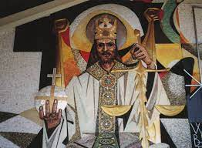
Whatever comes, remember
Jesus Christ, “who has gone into heaven and is at the right hand of God, with angels, authorities, and powers having been subjected to him” (1 Peter 3:21-22)
“Therefore, preparing your minds for action, and being sober-minded, set your hope fully on the grace being brought to you by the revelation of Jesus Christ” (1:13)

Slide 79
Current cultural facts that inform our mediating function: 1. Individualism; 2. Big Government
“Individualism tends to weaken mediating power centers that stand between the individual and the nation as a whole—from families to local communities (including local governments), (and) religious institutions…. In their place, it strengthens individuals, on the one hand, and a central government, on the other, since such a government is most able to treat individuals equally by treating them all impersonally. For this reason, a hyper-individualist culture is likely to be governed by a hyper-centralized government, and each is likely to exacerbate the worst inclinations of the other.” (Yuval Levin, The Fractured Republic, 99-100).

Slide 80
3. Digital Revolution; 4. Cultural Angst
The effects of hyper-individualism and “the state stepping in for Yahweh” have been magnified by the digital revolution. “The twenty-first century will be equivalent to 20,000 years of progress at today’s rate of progress.” (Ray Kurzweil of Google in Thomas Friedman, Thank You for Being Late)
“The rate of technological change is now accelerating so fast that it has risen above the average rate at which most people can absorb all these changes. Many of us can’t keep pace anymore. ‘And this is causing us cultural angst.’” (Thomas Friedman, Thank You for Being Late)

Slide 81
Is the lived experience of your congregation qualitatively different than any other association a person has during the week?
About congregations founded by Paul: “The truth of the good news’ (Galatians 2:14) is ineffective unless it ‘takes place’ within communities whose behavior instantiates its novelty.” (John M.G. Barclay, Paul & the Gift, 425)
“In a pluralist or secularizing context, churches now find themselves needing to rediscover their social, political, and cultural identity. Taken-for-granted criteria of value regarding age, ethnicity, social status, education, gender, health, or wealth become in such circumstances the object of critical reevaluation, and churches identify anew what it is about the good news that makes them socially and ideologically distinctive…. Paul provides resources for the dissolution of pre-formed assumptions and for the construction of boundary-erasing communities.” (John M. G. Barclay, Paul & the Gift, 573)

Slide 82
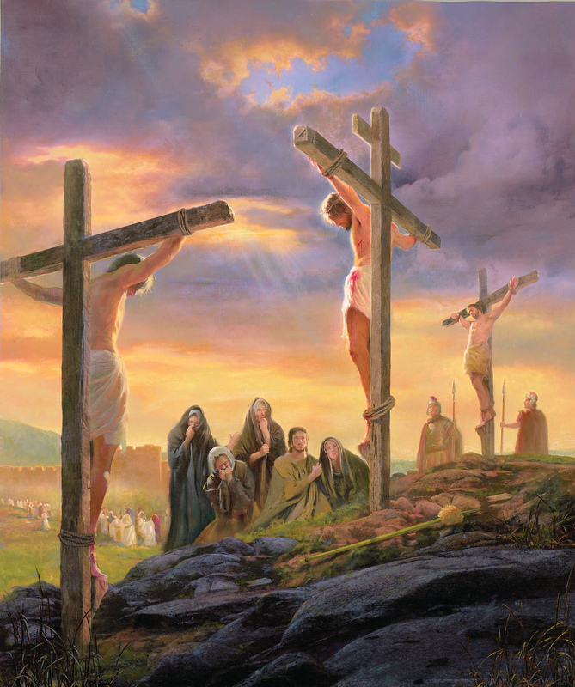
“God’s love does not find, but creates, that which is pleasing to it. Human love comes into being through that which is pleasing to it.” “Human love avoids sinners and evil persons. Thus Christ says (Matthew 9:13): ‘For I came to call not the righteous, but sinners.’
“This is the love of the cross, born of the cross, which turns in the direction where it does not find good, which it may enjoy, but where it may confer good upon the evil and needy person.” (Heidelberg Disputation, 28)

Slide 83
“Now when you have Christ as the foundation and chief blessing of your salvation, then the other part follows: that you take him as your example, giving yourself in service to your neighbor just as you see that Christ has given himself for you. See, there faith and love move forward, God’s commandment is fulfilled, and a person is happy and fearless to do and to suffer all things. Therefore, make note of this, that Christ as a gift (i.e., grace) nourishes your faith and makes you a Christian. But Christ as an example exercises your works. These do not make you a Christian. Actually, they come forth from you because you have already been made a Christian. As widely as a gift differs from an example, so widely does faith differ from works, for faith possesses nothing of its own, only the deeds and life of Christ. Works have something of our own in them, yet they should not belong to you but to your neighbor.” (“A Brief Instruction,” Luther’s Works, 35.120, from Barclay, Paul & the Gift, 110).

Slide 84
In conclusion…
“The ultimate soul-forming institutions in a free society are frequently religious institutions. Traditional religion offers a direct challenge to the ethic of the age of fracture. Religious commitments command us to a mixture of responsibility, sympathy, lawfulness, and righteousness that align our wants with our duties. They help form us to be free.” (Levin, 204)
“There is a yearning for a different way, especially among the young; a way that has integrity with the historic truths of the faith and the witness of the Spirit and that is adequate to the challenges of the present moment.” (James Davison Hunter, To Change the World, 276)

Slide 86
Christocentric What Does This Mean?

Slide 87
Yesterday: One Christ, and He Is Now!
Today: Christocentric means
Caring for Souls: This Worldliness
Tomorrow: The Goal of Soul Care: The Not Yet
First, let’s pull back again…

Slide 93
“This Worldliness”
“During the last year or so I’ve come to know and understand more and more the profound this-worldliness of Christianity. The Christian is not a homo religious, but simply a man, as Jesus was a man – in contrast, shall we say, to John the Baptist. I don’t mean the shallow and banal this-worldliness of the enlightened, the busy, the comfortable, or the lascivious, but the profound this-worldliness, characterized by discipline and the constant knowledge of death and resurrection. I think Luther lived a this-worldly life in this sense.
“I remember a conversation that I had in America thirteen years ago with a young French pastor. We were asking ourselves quite simply what we wanted to do with our lives. He said he would like to become a saint (and I think it’s quite likely that he did become one). At the time, I was very impressed, but I disagreed with him, and said, in effect, that I should like to learn to have faith….

Slide 94
I discovered later, and I’m still discovering right up to this moment, that it is only by living completely in this world that one learns to have faith. One must completely abandon any attempt to make something of oneself, whether it be a saint, or a converted sinner, or a churchman (a so-called priestly type!), a righteous man or an unrighteous one, a sick man or a healthy one. By this-worldliness I mean living unreservedly in life’s duties, problem, successes and failures, experiences and perplexities. In so doing we throw ourselves completely into the arms of God, taking seriously, not our own sufferings, but those of God in the world – watching with Christ in Gethsemane. That, I think, is faith; that is metanoia; and that is how one comes a man and a Christian.
“May God in His mercy lead us through these times; but above all, may He lead us to Himself.” (Letters and Papers from Prison, Collier; pp. 369-370)

Slide 95
Bonhoeffer was a theological intellectual who sought faith by plunging himself into “this worldliness”.
What about people and parishioners who are hurting in their lives, in their own Gethsemanes, but have only shallow biblical knowledge?
How do we provide soul care for them?

Slide 102
Mediating Institutions
Families
Local Governments
Community Organizations
Veterans’ Organizations
Unions
Lodges
Clubs
and
Your Congregation

Slide 103
What is a “mediating institution”?
“One of the most vital insights of modern social thought is the importance of mediating institutions–churches, schools, fraternal organizations, professional associations, and even clubs–for a free society. Not only are they effective, sometimes crucial, in providing services of all sorts, they are, as Tocqueville pointed out, a bulwark of freedom against the encroaching power of the state. The recognition of the consequence of these associations is especially significant for Americans because we have been particularly adept at forming them.” (Mediating Institutions, William Klimon, Acton Institute)

Slide 104
1 Peter demonstrates the mediating function of faith: How should a believer interact with an impersonal, sometimes cruel society?
General rubric:
1 Peter 2:11-12 – “Beloved, I urge you as sojourners and exiles to abstain from the passions of the flesh, which wage war against your soul. Keep your conduct among the Gentiles honorable, so that when they speak against you as evildoers, they may see your good deeds and glory God on the day of visitation.”
Specific vocational instruction:
2:13-17 – In subordination to government
2:18-25 – In subordination to masters
3:1-6 – In subordination to unbelieving husbands
3:7 – Believing husbands toward wives
3:8-12 – In general

Slide 105
Threads through 2:11-3:12
Subordination (hyptasso) because of Christ (dia ton kyrion)
Good works
As is the will of God (v. emotion-driven conduct)
As witness to non-Christian society
But if you still suffer, look to Christ who
suffered unjustly
but is now exalted, just as you will be vindicated and honored when He appears in glory.
“And who will harm you, if you are eager to do good? But even if you might suffer because of righteousness (Christ), you are blessed” (3:13)

Slide 106
It is almost impossible for us to put ourselves in their shoes. E.g., Government, 2:13-17
No separation of Church and State (First Amendment)
No automatic citizenship (14th Amendment): Historically citizenship by birth was only to people born in the city of Rome. By the first century B.C. it was extended to all in Italy. It was often given to soldiers upon retirement. A slave could purchase his freedom or have it given to him by his master. In such a case, the slave, now a freedman, was still obligated to his former master. In 212 A.D. the Emperor Caracalla extended citizenship to all within the Empire. (Constitutio Antoniniana)

Slide 107
No Due Process (14th Amendment)
“This is the course that I have adopted in the case of those brought before me as Christians. I ask them if they are Christians. If they admit it, I repeat the question a second and a third time, threatening capital punishment; if they persist, I sentence them to death. For I do not doubt that, whatever kind of crime it may be to which they have confessed, their pertinacity and inflexible obstinacy should certainly be punished. There were others who displayed a like madness and whom I reserved to be sent to Rome, since they were Roman citizens. Thereupon the usual result follow; the very fact of my dealing with the question led to a wider spread of the charge, and a great variety of cases were brought before me. An anonymous pamphlet was issued, containing many names. All who denied that they were or had been Christians I considered should be discharged, because they called upon the gods at my dictation and did reverence, with incense and wine, to your image…” (Pliny to Trajan, 112 A.D.)

Slide 108
Bridging from then to now…
Peter is not-negative about the Roman Empire
Purpose of government: Praise those who do good; punish those who do evil.
Appeal was possible for citizens, but nothing like our Due Process
Duties of Christians: Fear God, honor (not worship) the Emperor
“Be subject to every human creature”

Slide 109
E.g., Slaves – 2:18-25
Rome came down hard when slaves used violence. When a slave broke an expensive goblet as his master Vedius Pollio was hosting Caesar Augustus, Pollio commanded the slave be thrown into a pool he had built and filled with lampreys. The slave begged Augustus for mercy, the emperor broke more of Pollio’s goblets, making himself guilty of the same offence, and thus the slave was spared. (Seneca).
During the reign of Nero, Pedanius Secundus, prefect of Rome, was murdered by one of his 400 household slaves. “Ancient custom required that the whole slave establishment which had dwelt under the same roof be dragged to execution.”

Slide 110
Slaves were usually suspect, and by the mid first century the diversity of the slave population was more worrisome. This would especially apply to Christian slaves, whose profession of faith could be viewed as subversive to the welfare of general society.
“Our ancestors always suspected the temper of their slaves, even when they were born on the same estates, or in the same houses with themselves and thus inherited from their birth an affection for their masters. But now that we have in our households nations with different customs to our own, with a foreign worship or none at all, it is only by terror you can hold in such a motley rabble.”(Tacitus, Annales, XIV, 42-44)

Slide 111
Bridging from then to now…
Nota Bene: Slavery was never questioned in ancient Greek or Roman society.
Care about how you talk about faith in the workplace. Cf. 1 Peter 3:15
If you are reviewed poorly or otherwise suffer, do not let it come from your own wrongdoing.
Endure injustice remembering Christ.
Unlike slaves in the Roman Empire, you can change jobs!

Slide 112
Wives of Unbelieving Husbands – 3:1-6 Believing Husbands – 3:7
“Be subject to your own husbands, so that even if some do not obey the word, they may be won without a word by the conduct of their wives.”
“Live with your wives according to (Christian) knowledge.”

Slide 113
3:8-12
To all…
“Whoever desires to love life and see good days, let him keep his tongue from evil and his lips from speaking deceit; let him turn away from evil and do good; let him seek peace and pursue it. For the eyes of the Lord are on the righteous and his ears are open to their prayer. But the face of the Lord is against those who do evil” (Psalm 34:13-17)

Slide 114
What habits from back then should characterize our mediating function today?
GATHER
“The end of all things is at hand; therefore, be self-controlled and sober-minded for the sake of your prayers. Above all, keep loving one another earnestly, since love covers a multitude of sins. Show hospitality to one another without grumbling. As each has received a gift, use it to serve one another…” (1 Peter 4:7-10)

Slide 115
Gather > Grow > Go
GROW in distinguishing the majority culture from our Christocentric church culture:
Emotional drivers (1:14; 2:11; 4:2) vs.
Bible study (1:23-25; 2:2)
God’s will: obedience (1:15-17; 4:2)
GO into non-Christian society
To serve
As Christ served
As witness
Voluntary subordination

Slide 116
Whatever comes, remember
Jesus Christ, “who has gone into heaven and is at the right hand of God, with angels, authorities, and powers having been subjected to him” (1 Peter 3:21-22)
“Therefore, preparing your minds for action, and being sober-minded, set your hope fully on the grace being brought to you by the revelation of Jesus Christ” (1:13)

Slide 117
Current cultural facts that inform our mediating function: 1. Individualism; 2. Big Government
“Individualism tends to weaken mediating power centers that stand between the individual and the nation as a whole—from families to local communities (including local governments), (and) religious institutions…. In their place, it strengthens individuals, on the one hand, and a central government, on the other, since such a government is most able to treat individuals equally by treating them all impersonally. For this reason, a hyper-individualist culture is likely to be governed by a hyper-centralized government, and each is likely to exacerbate the worst inclinations of the other.” (Yuval Levin, The Fractured Republic, 99-100).

Slide 118
3. Digital Revolution; 4. Cultural Angst
The effects of hyper-individualism and “the state stepping in for Yahweh” have been magnified by the digital revolution. “The twenty-first century will be equivalent to 20,000 years of progress at today’s rate of progress.” (Ray Kurzweil of Google in Thomas Friedman, Thank You for Being Late)
“The rate of technological change is now accelerating so fast that it has risen above the average rate at which most people can absorb all these changes. Many of us can’t keep pace anymore. ‘And this is causing us cultural angst.’” (Thomas Friedman, Thank You for Being Late)

Slide 119
Is the lived experience of your congregation qualitatively different than any other association a person has during the week?
About congregations founded by Paul: “The truth of the good news’ (Galatians 2:14) is ineffective unless it ‘takes place’ within communities whose behavior instantiates its novelty.” (John M.G. Barclay, Paul & the Gift, 425)
“In a pluralist or secularizing context, churches now find themselves needing to rediscover their social, political, and cultural identity. Taken-for-granted criteria of value regarding age, ethnicity, social status, education, gender, health, or wealth become in such circumstances the object of critical reevaluation, and churches identify anew what it is about the good news that makes them socially and ideologically distinctive…. Paul provides resources for the dissolution of pre-formed assumptions and for the construction of boundary-erasing communities.” (John M. G. Barclay, Paul & the Gift, 573)

Slide 120
“God’s love does not find, but creates, that which is pleasing to it. Human love comes into being through that which is pleasing to it.” “Human love avoids sinners and evil persons. Thus Christ says (Matthew 9:13): ‘For I came to call not the righteous, but sinners.’
“This is the love of the cross, born of the cross, which turns in the direction where it does not find good, which it may enjoy, but where it may confer good upon the evil and needy person.” (Heidelberg Disputation, 28)

Slide 121
“Now when you have Christ as the foundation and chief blessing of your salvation, then the other part follows: that you take him as your example, giving yourself in service to your neighbor just as you see that Christ has given himself for you. See, there faith and love move forward, God’s commandment is fulfilled, and a person is happy and fearless to do and to suffer all things. Therefore, make note of this, that Christ as a gift (i.e., grace) nourishes your faith and makes you a Christian. But Christ as an example exercises your works. These do not make you a Christian. Actually, they come forth from you because you have already been made a Christian. As widely as a gift differs from an example, so widely does faith differ from works, for faith possesses nothing of its own, only the deeds and life of Christ. Works have something of our own in them, yet they should not belong to you but to your neighbor.” (“A Brief Instruction,” Luther’s Works, 35.120, from Barclay, Paul & the Gift, 110).

Slide 122
In conclusion…
“The ultimate soul-forming institutions in a free society are frequently religious institutions. Traditional religion offers a direct challenge to the ethic of the age of fracture. Religious commitments command us to a mixture of responsibility, sympathy, lawfulness, and righteousness that align our wants with our duties. They help form us to be free.” (Levin, 204)
“There is a yearning for a different way, especially among the young; a way that has integrity with the historic truths of the faith and the witness of the Spirit and that is adequate to the challenges of the present moment.” (James Davison Hunter, To Change the World, 276)

